Slide 1
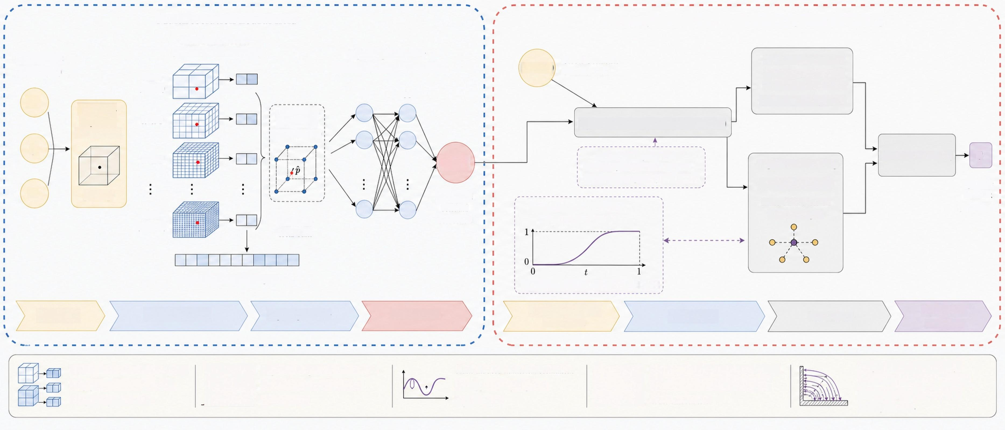
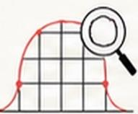
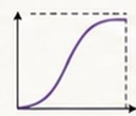
Multiresolution neural
field
Boundary-informed constraint
and regularized learning
HashGrid encoder
query point
p=(x,y,z)
(16 levels,2 features /level)
Lightweight decoder
Global Geometric ^{UGGGP(p)} _{Guidance} _{Field}
Boundary cosine loss
align with inner-wall and outer-boundary directions Lbc=1-cos(upred,nb)
(2 hidden layers,64 neurons,SiLU)
coarse
(level 0)
64 64
x
Geometry-
dependent ^{level} ¹
8 neighboring
lattice vertices
(for interpolation)
Upred(p)=γuGGGF(p)+f(d)(p;θ)
normalization
y
Hard boundary constraint: as d→0,residual vanishes and
Ltotal=aoLBe+a1Ltap
θ
level 2
Φ(p;θ)
Laplacian smoothing
near-wall orthogonality is enforced.
Clap=||V²upredll²
optimize
network parameters
Z
p→p
normalized
residual correction
finite differences on
interior samples
fine
C²-compatible interpolation
S2 (t)=6t5-15t4+10t³
(level 15)
multiscale local basis
32-d concatenated descriptor
replaces linear interpolation in HashGrid
Input point HashGrid encoder ^{Lightweight} ^{decoder} Residual field
Boundary-informed
formulation
Regularization
Loss
function
Optimization
parameters
Multiresolution HashGrid replaces
deep global MLP for localized, compact representation.
Captures sharp curvature variation
and localized CAD boundary- layer features.
Hash-induced numerical oscillations
are suppressed by Laplacian regularization.
Fifth-order smootherstep interpolation
ensures C²compatibility for second- order smoothness.
Output is a smooth,boundary-
constrained growth-direction field for anisotropic boundary-layer mesh generation.

